Slide 1
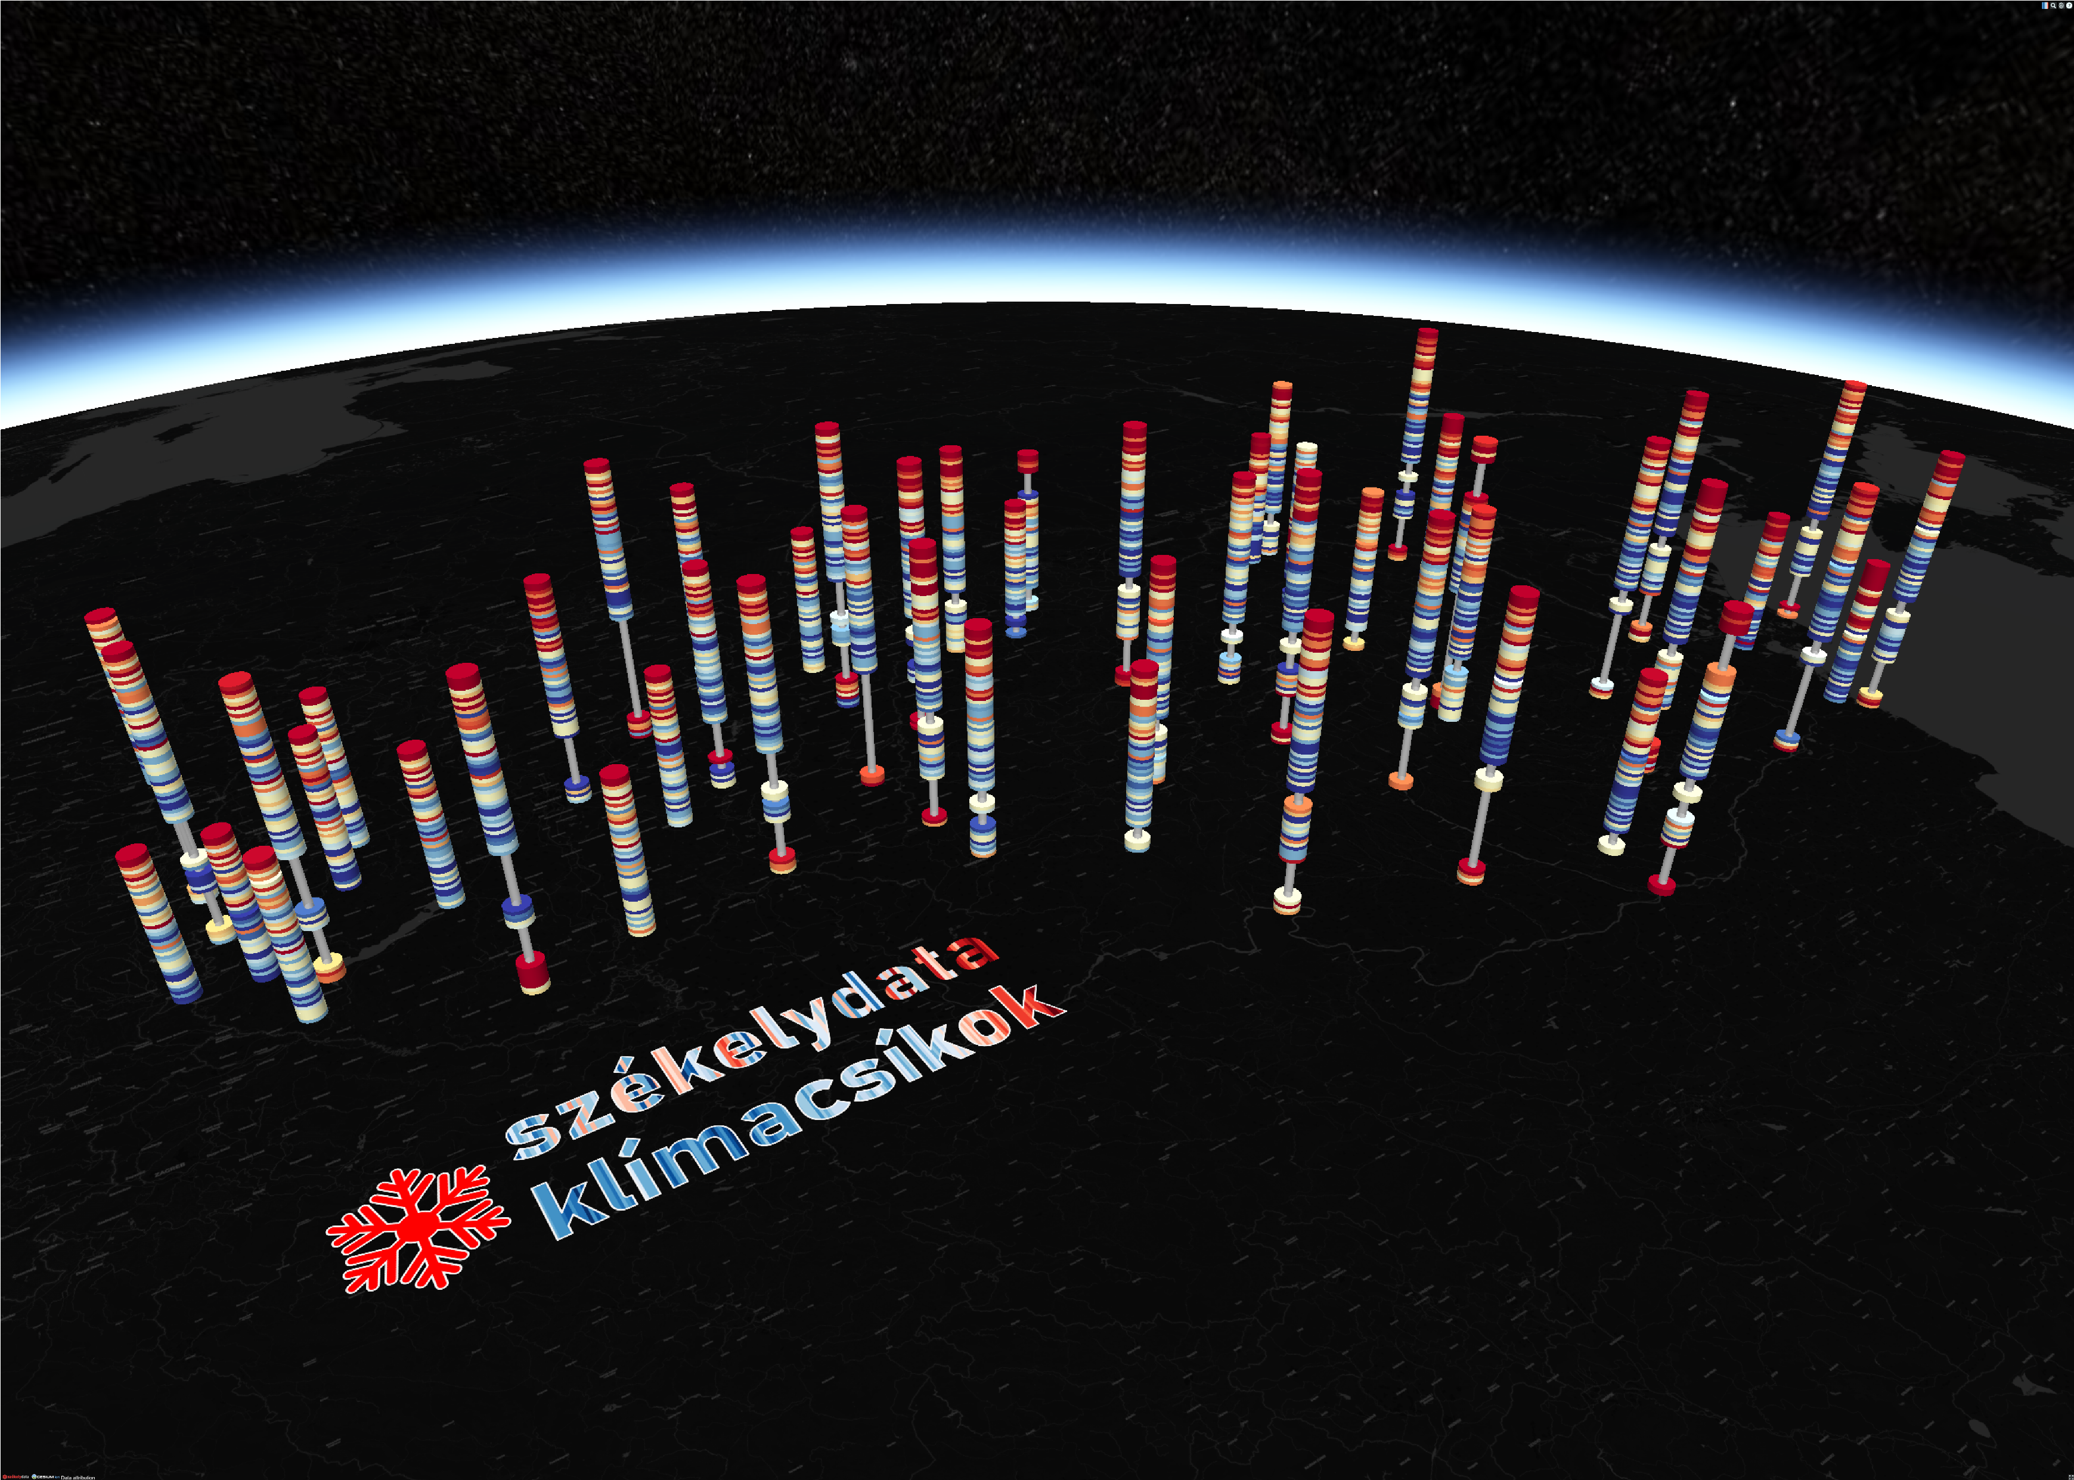
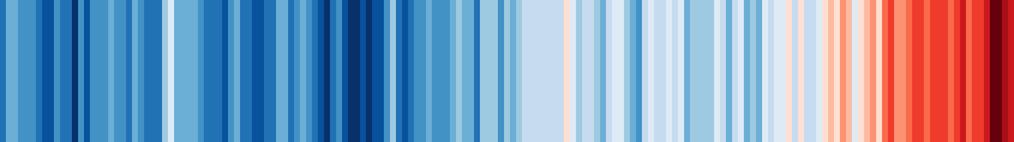
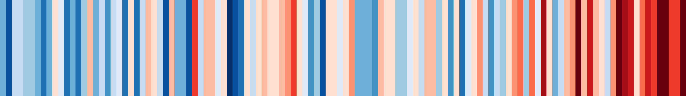
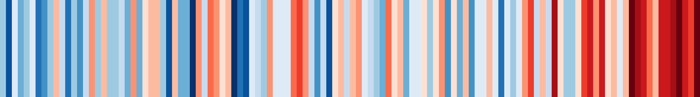
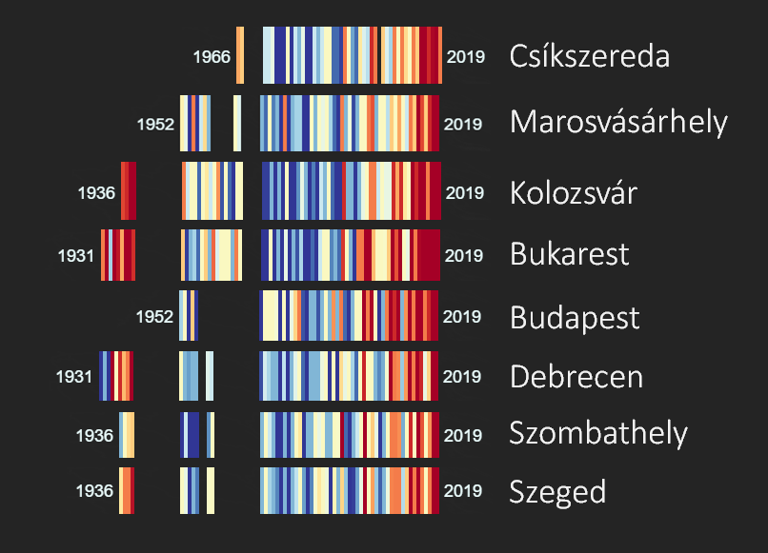


In 2019 Ed Hawkins created the famous #ShowYourStripes visualization to raise awareness about climate change. Each stripe represents the temperature averaged over a year. He conducted his analysis for countries.
For virtually every country, the stripes turn from mainly blue to mainly red in more recent years, illustrating the rise in average temperatures in each country. We repeated his analysis on a high-resolution, weather station level in Hungary and Romania – and found that every single station followed the warming trend.
1850 Global warming stripes 2018
1901 Hungary warming stripes 2018
1901 Romania warming stripes 2018
székelydata klímacsíkok
weather station level climate warming stripes for Hungary and Romania
Dénes Csala | székelydata | 2019
data: NOAA (1931-2019)

Slide 2
In 2019 Ed Hawkins created the famous #ShowYourStripes visualization to raise awareness about climate change. Each stripe represents the temperature averaged over a year. He conducted his analysis for countries.
For virtually every country, the stripes turn from mainly blue to mainly red in more recent years, illustrating the rise in average temperatures in each country. We repeated his analysis on a high-resolution, weather station level in Hungary and Romania – and found that every single station followed the warming trend.
1850 Global warming stripes 2018
1901 Hungary warming stripes 2018
1901 Romania warming stripes 2018
székelydata klímacsíkok
weather station level climate warming stripes for Hungary and Romania
Dénes Csala | székelydata | 2019
data: NOAA (1931-2019)

